Slide 1
Data Mining Functionalities
Specify kinds of Patterns viewed -DM tasks

Slide 2
What can be Discovered
Kind of patterns based on DM tasks
Data mining tasks
    Descriptive
    Predictive
Descriptive
  Characterize the general properties
Predictive
  Constructing one or more sets of data models,
  performing inference on the available set of data,
  attempting to predict the behaviour of new data sets. Ex: classification

Slide 3
DM Functionalities- that discover kinds of patterns
Concept / Class description
Mining frequent Patterns, Associations & Correlations
Classification & Prediction
Cluster Analysis
Outlier Analysis
Evolution Analysis

Slide 4
Concept/ Class description
Referred as data to be associated with classes or concepts
Classes of items for sales include computer and printers,
Concepts of customers include big spenders and budget spenders.
describe individual classes and concepts in summarized , concise and yet precise terms
Such descriptions of a class or concept- class/concept descriptions
Descriptions can be derived via
  Data characterization
  Data discrimination
  Or Both

Slide 5
Data Characterization (DC)
Target Class –
refers to summarizing data of class under study. This class under study is called as Target Class
Summarization of general characteristics/ features of class
collected by a database query
characteristics of customers who spend more than $1000 a year at shop
characteristics of software products whose sales increased by 10% in the last year
Effective method - data summarization and characterization based on
statistical measure and plots
Resulting characteristic descriptions- output
presented in generalized relations/rule – characteristic rules
(pie chart, bar graph, curves, multidimensional tables, etc) - Attributed oriented induction technique
Result- General profile of customer –age (40-50), employed, credit ratings

Slide 6
Data Discrimination
Contrasting Classes- It refers to the mapping or classification
of a class with some predefined group or class.
Comparison of the target class with one or a set of comparative classes
To compare the general features of software products whose sales increased by 10%
in the last year with those whose sales decreased by at least 30% during the same period
Same Effective method - data discrimination based on
statistical measure and plots
Resulting discrimination descriptions- Discrimination rules
include comparative measure – distinguish target and contrasting class
Result- buying compute products

Slide 7
II Mining Frequent Patterns (MFP)
Patterns that occur frequently
Kinds of frequent patterns
    Item sets
    subsequences
    sub structures

Slide 8
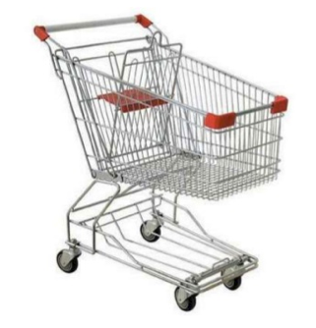
II Mining Frequent Patterns (MFP)
Frequent Item-sets Refers to a set of items that frequently appear together in a transactional data set
Very common problem in Market-Basket applications
Given a set of items I ={milk, bread, jelly, …}
Given a set of transactions where each
transaction contains subset of items
t1 = {milk, bread, water}
t2 = {milk, nuts, butter, rice}

Slide 9
MFP
Sub sequence - A frequently occurring sub sequence
Ex: pattern that customers tend to purchase first a PC, followed by a digital camera, and then a memory card, is a sequential pattern
Substructure
Different structural forms, such as graphs or trees which may be combined with item sets or subsequence
Mining frequent patterns lead to the discovery of
association and correlation

Slide 10
Association
Studies the frequency of items occurring in the TDB
Written in the form of association rules
Based on the threshold ( conditional probability)
  Support (% analysis result)
  Confidence (% of chance)
  Used for Market – Basket Analysis

Slide 11
Association (EX) & Correlation
Association
Items frequently purchased together within the same transactions.
The rule is:
Buys(X, “computer”) ➔ buys(X, ”software”)
[support = 1%, confidence = 50% ]
Association rule - one predicate – buys(simplified)
computer ➔ software [1%, 50%]”
Correlation
Another statistical analysis performed in the patterns.

Slide 12
Classification - organization of data
Supervised Classification
Process of finding a model/ function - describes & distinguishes data classes or concepts
model to predict the class of objects class label is unknown
Uses training set – with a class labels
Classification algorithm learns from training set build a model
to classify new objects

Slide 13
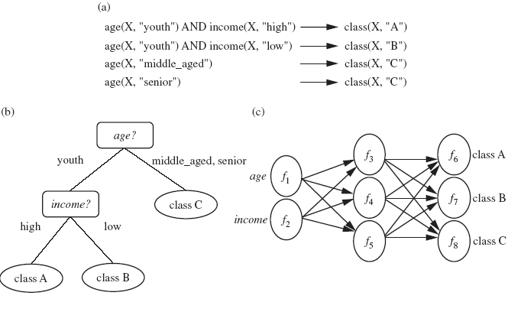
cont… Classification
The derived model represented in various forms
if-then rule, decision tree or neural network

Slide 14
Model (if-then rule)
To classify a large set of store items based on three kinds of responses: good, mild and no response
Model in if-then rule
age(X, ”youth”) AND income(X,” high”) ➔ class(X,”A”)
age(X, ”youth”) AND income(X,” low”) ➔ class(X,”B”)
age(X,” middle-aged”) ➔ class(X,”C”)
age(X,” senior”) ➔ class(X,”C”)

Slide 15
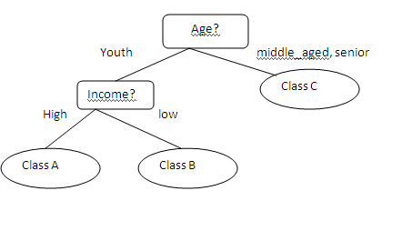
Model (decision tree)

Slide 16
Classification- Prediction
Classification predicts categorical (discrete/ unordered) data
Prediction predicts continuous-value and missing or unavailable numerical data values rather than class labels
Prediction of numerical data - Regression Analysis

Slide 17
Cluster Analysis- organization of data
Unsupervised Classification
Clustering - set of objects into groups
Similar to classification, class labels are unknown
Clustering algorithm discovers the classes
Used to organize the data whose class labels are unknown

Slide 18
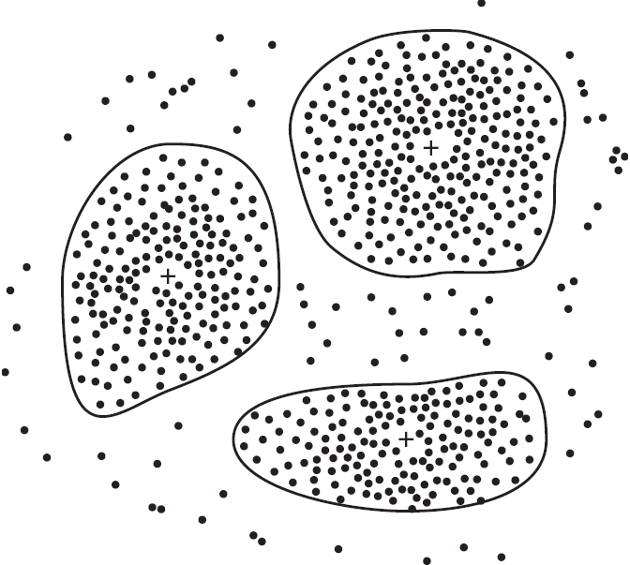
Cont… Cluster Analysis
homogeneous subpopulations of customers- individual target groups for marketing
2-D plot of customers with respect to customer locations in a city.
To cluster the cancer and non-cancer patient details
Cancer related data will be grouped into one set
and the remaining will be grouped
into another set
To cluster the high, medium and
low marks of n students

Slide 19
Outlier Analysis
A database may contain data objects that do not obey with the general behavior or model of the data - outliers
Outlier elements cannot be grouped in a given class or cluster -Known as exceptions or surprises

Slide 20
Outlier Analysis (Very important in some cases)
Most data mining methods discard outliers as noise or exceptions
Application fraud detection, the rare events more interesting than the more regularly occurring ones
The analysis of outlier data is known as outlier mining
Eg. uncover fraudulent usage of credit cards - detecting purchases of extremely large amounts

Slide 21
Evolution Analysis
Data evolution analysis describes and models the regularities or trends for objects whose behavior changes over time
Models evolutionary trends in data which provide a way for characterizing, comparing, classifying or clustering of time related data

Slide 22
Notes:
<number>

